Slide 1
TWITTER US-CANADA AIRLINE ANALYSIS using HADOOP and HIVE
BATCH 1 GROUP 7
SWARN JAIN
SUPARNO BHATTA
OYINDRILA SEN GUPTA
PRATIK MUKESH SAVLA
SRIVATS S RAMANUJAM

Slide 2
TABLE OF CONTENTS
Abstract
Dataset
Fundamentals
Python File for Pre Processing
Add user and Data Ingestion
Setting Permission and starting hive
Create Table
Data Cleansing
Count of the Data
Finding Airline specific Negative Reviews
Output of the Query
Sentiments of Passengers
Confidence of Tweets
Business Case Scenario
Conclusion and Future Work

Slide 3
ABSTRACT
This data originally came from Crowdflowers Data for Everyone library. This is a Sentiment Analysis on each major U.S. and Canada airlines and their reviews. Twitter data was scraped from February of 2015 and contributors were asked to first classify positive, negative, and neutral tweets, followed by categorizing negative reasons such as "late flight" or "rude service”. Hive is used for ingestion and transformation of data.

Slide 4
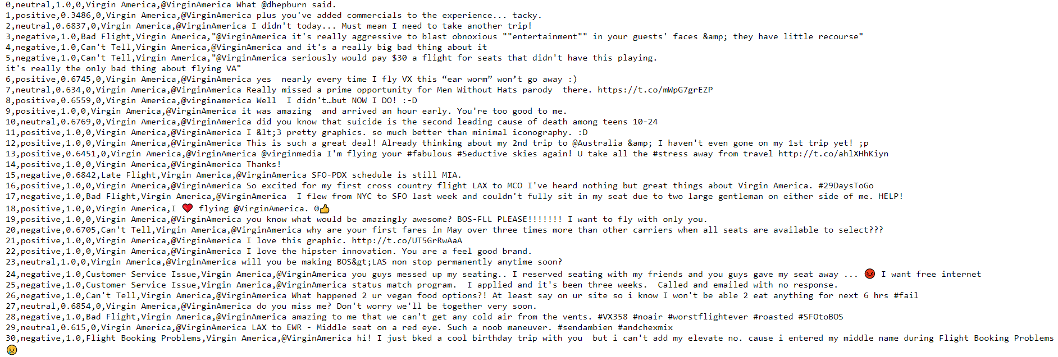
DATASET
Preprocessed data that was uploaded in github

Slide 5
PYTHON FILE FOR PREPROCESSING
Removing columns not relevant to the business case.
Replacing commas with spaces as the ingestion was a problem.
Adding 0 to missing values in the negativereason column for all positive and neutral values.
Upload the file.

Slide 6
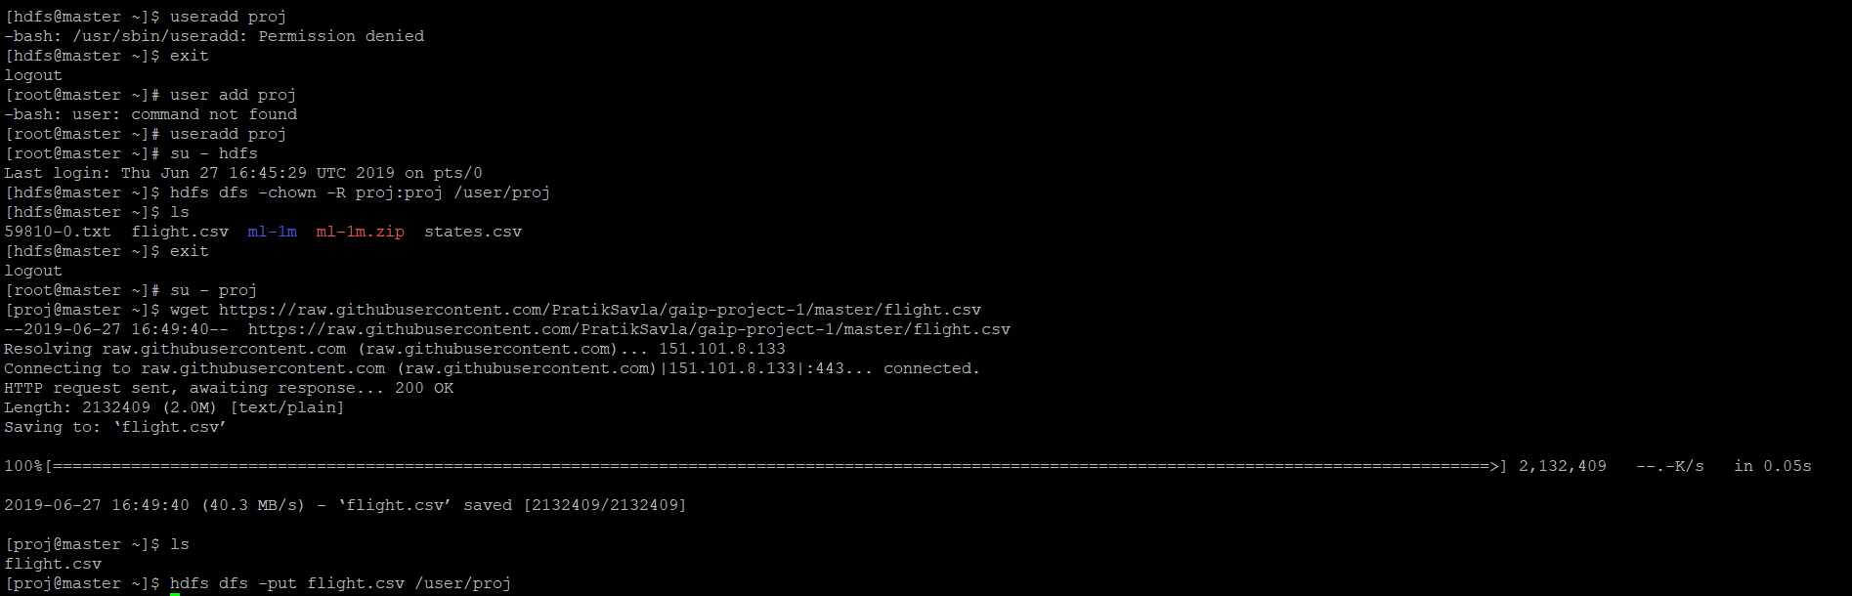
ADD USER AND DATA INGESTION
Downloading the csv file using wget.
Create a new user proj.
Change owner of the downloaded file flight.csv.
Using hdfs dfs –put ‘filename’ ‘directory’.

Slide 7
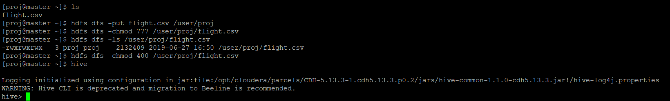
SETTING PERMISSIONS AND STARTING HIVE
Setting permission to the file.
Open hive from the newly created user.

Slide 8
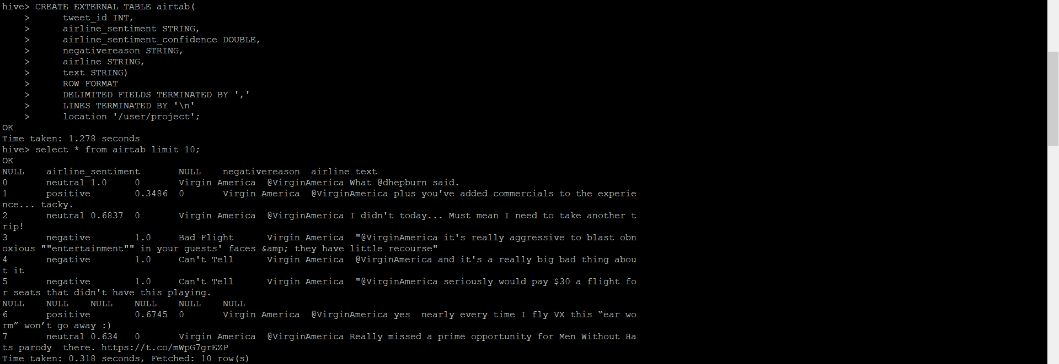
CREATE TABLE
Create table airtab with all the required columns.
Printing first 10 values.

Slide 9
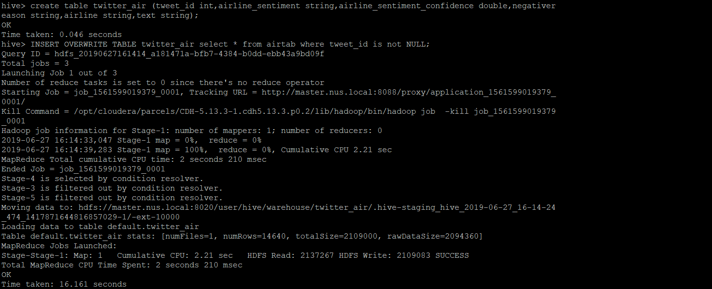
DATA CLEANSING IN HIVE
Data had NULL values to be cleared.
Create a new table twitter_air which selects column without null values.

Slide 10
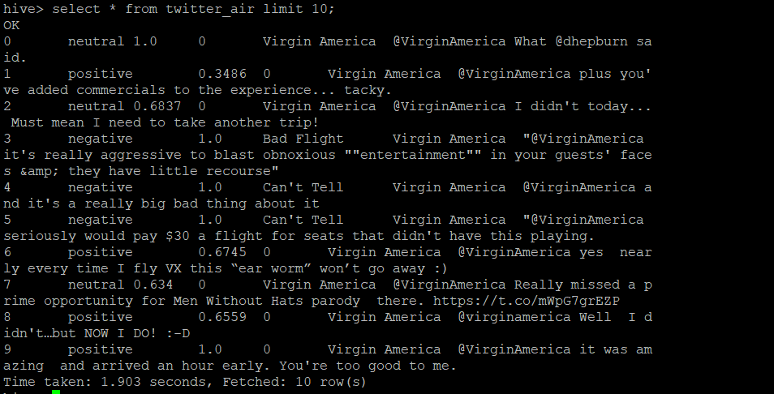
OUTPUT OF DATA CLEANSING
NULL values have been removed.
Cleansed value into new table.

Slide 11
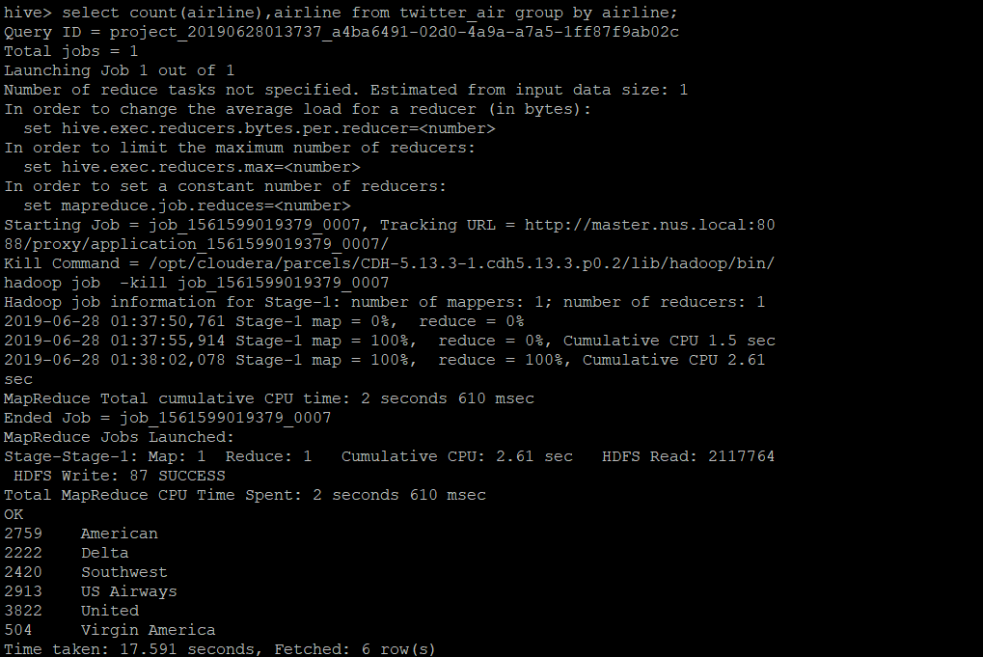
COUNT OF THE DATA
Count of total number of reviews for all airlines.

Slide 12
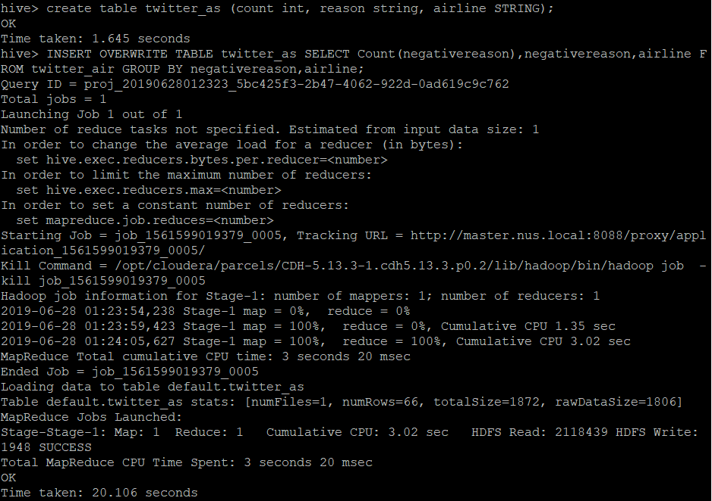
FINDING AIRLINE SPECIFIC NEGATIVE REVIEWS
Query to put the negative reason, its count and which airline is the reason for it in a table.
Selecting this newly created table twitter_as will give us the output of the query.

Slide 13
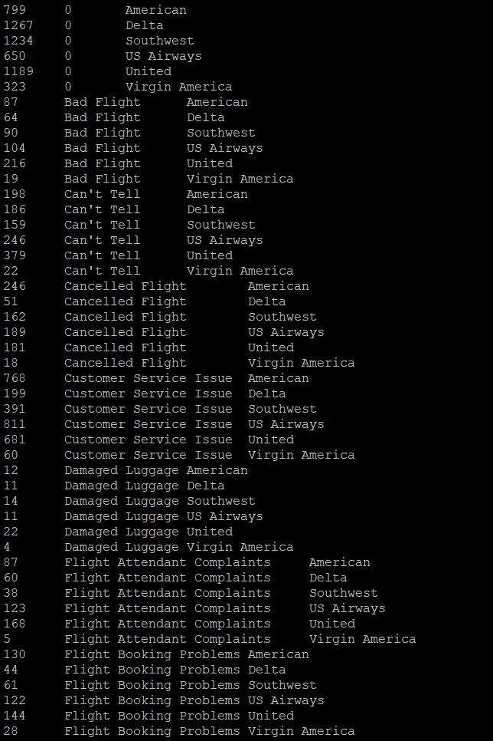
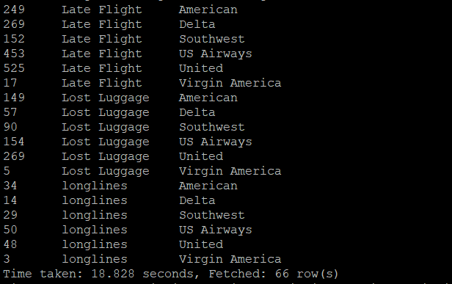
OUTPUT OF THE QUERY
From this, an inference can be made that certain airlines lack their service in certain areas.
Highest number of complaints was recorded for Customer Service Issue.
Many Inferences are possible from this output.

Slide 14
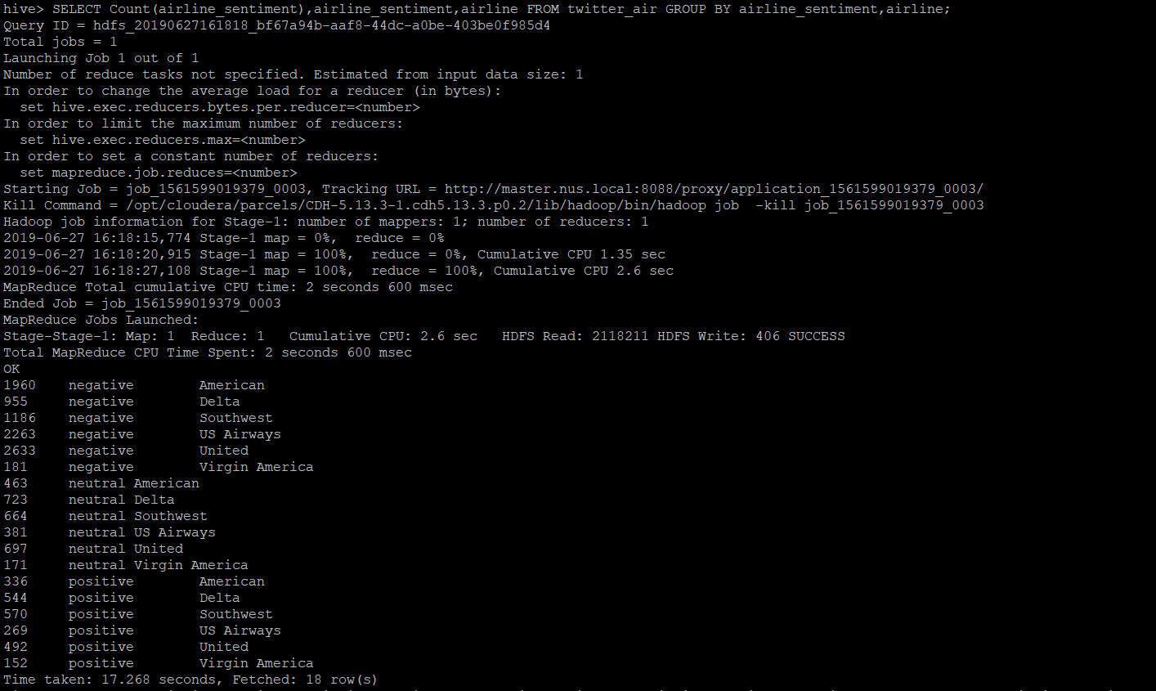
SENTIMENTS OF PASSENGERS
Count of positive, negative and neutral reviews for all the airlines.
A priority ranking can be made from this output.
GROUPBY divides table into smaller groups.

Slide 15
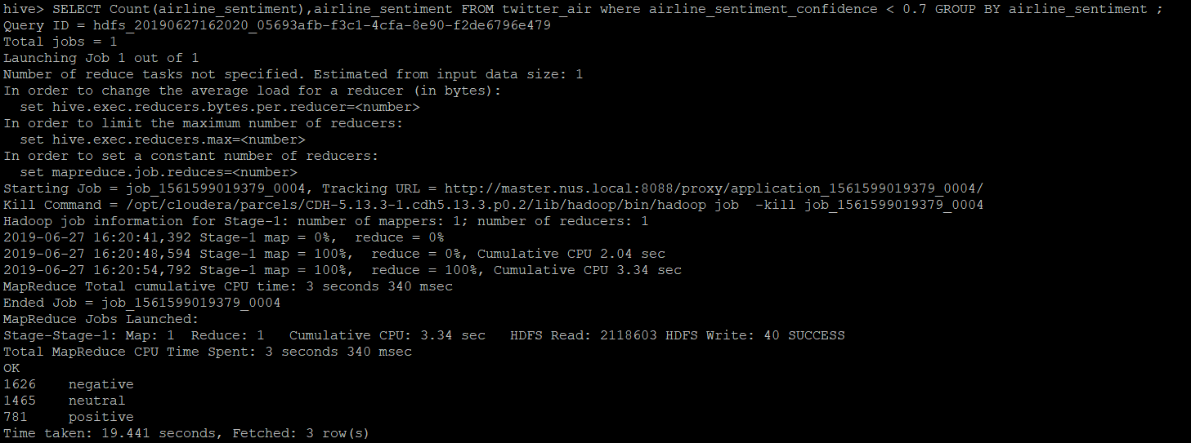
CONFIDENCE OF THE TWEETS
Finding the reliability of the tweets.
Idea is to help people find out which tweet/review they can trust more.

Slide 16
BUISNESS CASE SCENARIO
Passengers would be able to know which airline to choose according to their priorities.
They would also get to know which airline they must avoid for specified reasons.
Companies also get to know where their competitors are better than them.
Companies will be able to get to know where they lack in their services and improve them.

Slide 17
CONCLUSION AND FUTURE WORK
Twitter Sentiment Analysis has been a trending topic for all companies world wide to get to know about themselves from their customers.
People can also get to know about these companies before becoming their customers.
Companies can improve their sales and service based on this analysis.
More analysis can be done on the data that will provide better insights for the people.
Increasing the Volume and acquiring real time data and processing on it will provide live and better results for people to rely on.
Extracting the queried data and visualizing using graphs can be done.

Slide 18
QUESTIONS?

Slide 19
THANK YOU

